Slide 1


Lecture 1-6 Advanced Web App Architecture
CSE 446/598 Software Integration and Engineering
Unit 1 Service Standards and Service Development
Dr. Yinong Chen
https://myasucourses.asu.edu/

Slide 2
Lecture Outline
ASP .Net Web Application Architecture
HTML5 Application
Case Study
MVC 2 Web Application Architecture
Case Study

Slide 3
The Evaluation Web Technologies
WCF RESTful Service
ASP .Net MVC 1 Application
Web API
RESTful Service
ASP .Net Core Web Application MVC 2
ASP .Net Web Application
WCF SOAP Service
HTML5
Single Page Application with Client Side Computing
ASP .Net SOAP Service
HTML CSS
Java-Script &
JQuery
Canvas SVG WebGL
Desktop-based Forms Application
ASP .Net Framework
ASP .Net Core Framework
Other Frameworks
such as Netbeans

Slide 4
Review: ASP .Net Web Application Architecture
ASP .Net comes from object-oriented programming environment.
It makes it easier for developers with OO development experience.
It places the presentation layer files (.aspx) and the controller file (.aspx.cs) together.
It generates html file based on .aspx file.
The advantages
Related items are placed together.
It matches OO and is easy to develop based on OO principles.
The disadvantages:
Mix two tiers together (View and Controller) and add dependency.
ViewState is not well supported in server farms/cloud computing environments
MyWebApp root
Global.asax
Web.config
.aspx & aspx.cs
files
.ascx & ascx.cs
files
.aspx & aspx.cs
files
.ascx & ascx.cs
files
.aspx & aspx.cs
files
.ascx & ascx.cs
files
ASP .Net Web Application
User defined dir
App_Data
bin
.aspx & aspx.cs
files
.dll
file
.aspx & aspx.cs
files
XML file
.aspx
files
.aspx & aspx.cs
files
Web
.config
DB file
.exe
file
.aspx
files
.aspx
files
XML file
.aspx
files
.aspx
files
XML file
.aspx
files

Slide 5
The Evaluation Web Technologies
WCF RESTful Service
ASP .Net MVC 1 Application
Web API
RESTful Service
ASP .Net Core Web Application MVC 2
ASP .Net Web Application
WCF SOAP Service
HTML5
Single Page Application with Client Side Computing
ASP .Net SOAP Service
HTML CSS
Java-Script &
JQuery
Canvas SVG WebGL
Desktop-based Forms Application
ASP .Net Framework
ASP .Net Core Framework
Other Frameworks
such as Netbeans

Slide 6
From HTML to HTML5
Reference: http://www.w3schools.com/html/html5_intro.asp
<!DOCTYPE html>
<html> <head> <meta charset="UTF-8"> <title> Doc Title </title> </head> <body> Content of the document...... </body> </html>
New semantic elements like <header>, <footer>, <article>, and <section>.
New form control attributes like number, date, time, calendar, and range.
New graphic elements like: <svg> and <canvas>.
New multimedia elements like: <audio> and <video>.
HTML5
Single Page Application with Client Side Computing
JavaScript and JQuery API Calls
HTML CSS
Java-Script &
JQuery
Canvas SVG WebGL
Become a Web Application Development Language

Slide 7
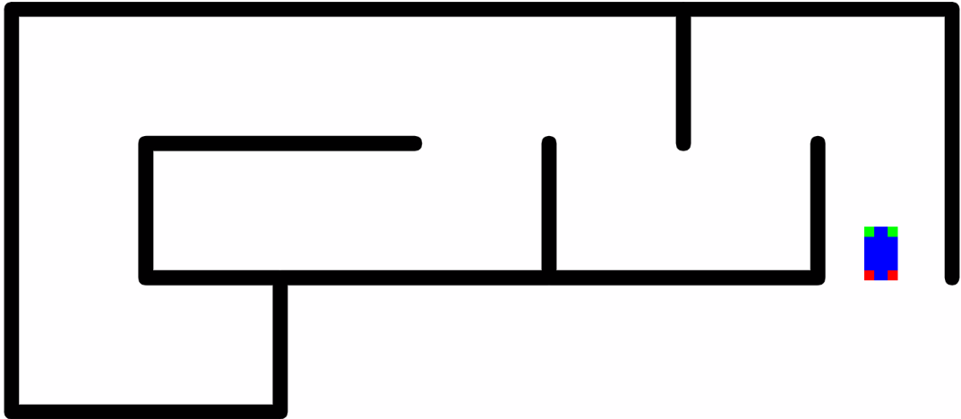
HTML 5 JavaScript API Library
Reference: http://html5index.org/
Web communication protocols
Web Sockets (Connection-oriented)
Messaging, and
WebRTC (Web Real-Time Communication)
Drag and Drop, Fullscreen
Canvas, SVG, WebGL
Animation Timing, Media, Pointer Lock, Web Audio
File API, File System API, Indexed DB, Offline, Web Storage
Browser, Shadow DOM, Typed Arrays, Web Workers
DOM and JQuery
CSS Object Model, Selectors
Example:
http://neptune.fulton.ad.asu.edu/VIPLE/Websimulator/

Slide 8
Canvas, SVG, or WebGL? Choose the right API
https://msdn.microsoft.com/en-us/library/dn265058%28v=vs.85%29.aspx?f=255&MSPPError=-2147217396
Canvas graphic library is the typical choice for most HTML5 applications. It's simple and speedy, particularly for games with many objects.
SVG: While canvas provides simplicity and speed, SVG provides flexibility. For example: Each graphic object is part of the DOM tree for flexible access, and each graphic object in the application can have one or more associated event handlers for processing.
WebGL: If you are already familiar with OpenGL, you can use WebGL for a simple 2D application. If you are not, this API is more complex than you need for a simple graphic application.

Slide 9
Creating HTML5 Applications
Using Visual Studio
For HTML5 application development
Using NetBeans
For HTML5 application development

Slide 10
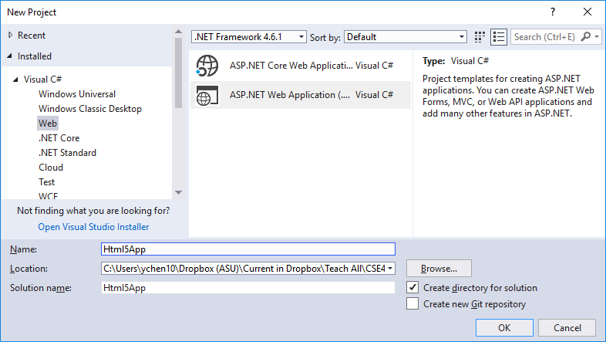
HTML5 Applications Using Visual Studio
File → New → Project …

Slide 11
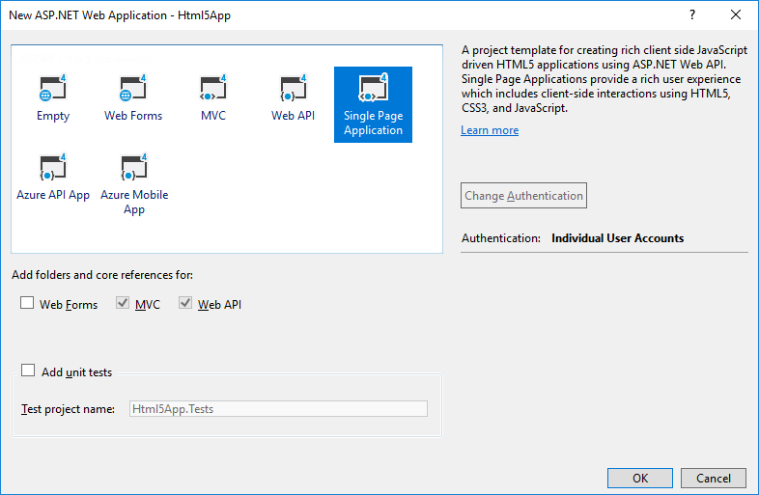
HTML5 Applications Using Visual Studio
Choose Single Page Application
It is considered a special case of MVC, with a single page only!

Slide 12
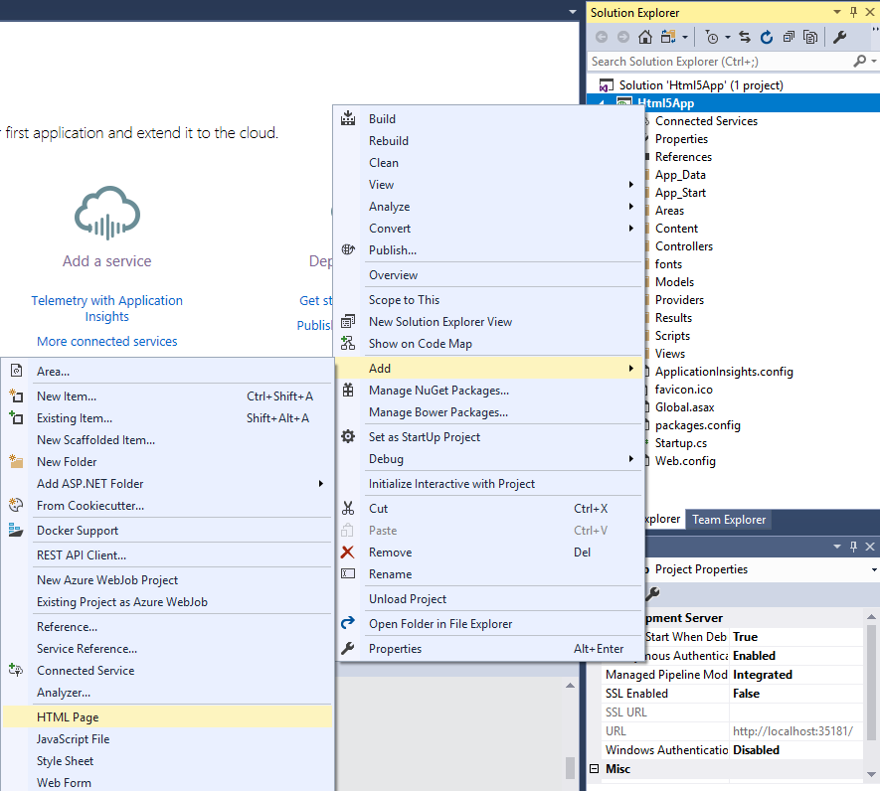
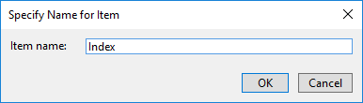
Adding an HTML Page as the Index Page

Slide 13
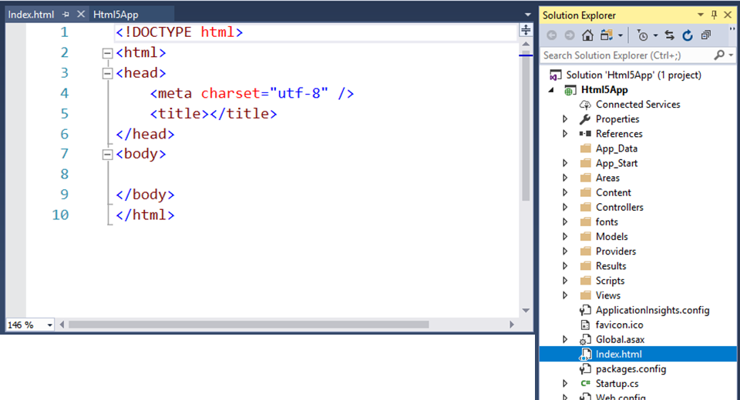
Index.html Page Created

Slide 14
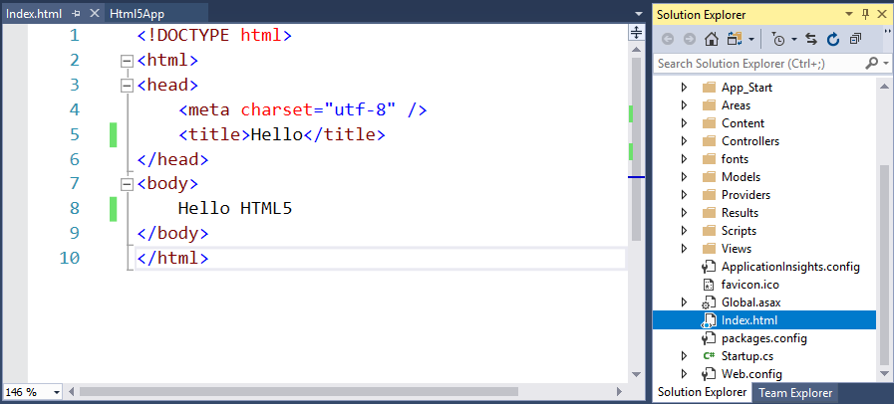

Hello HTML5
Right Click and choose View in Browser
Right Click, choose View in Browser

Slide 15
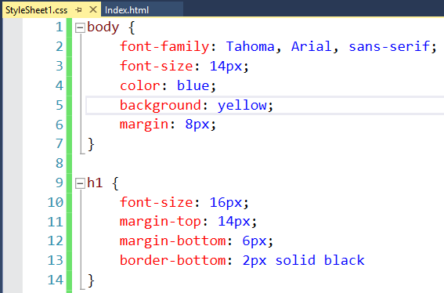
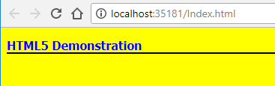
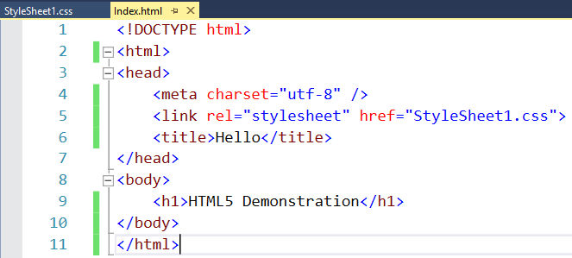
Adding CSS Stylesheet
Right Click Project → Add → Style Sheet
Name the page StyleSheet1, and link it into Index.html page
View in Web Browser

Slide 16
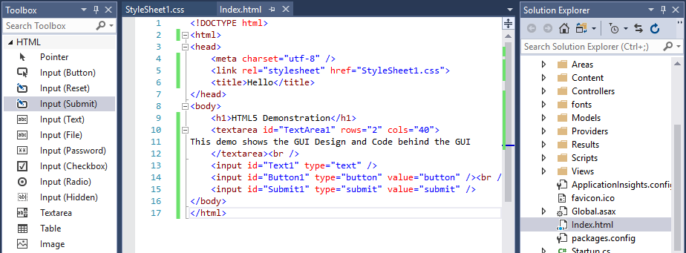
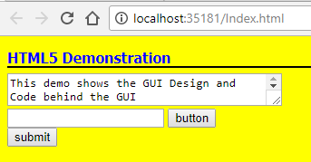
GUI Design
View in Web Browser

Slide 17
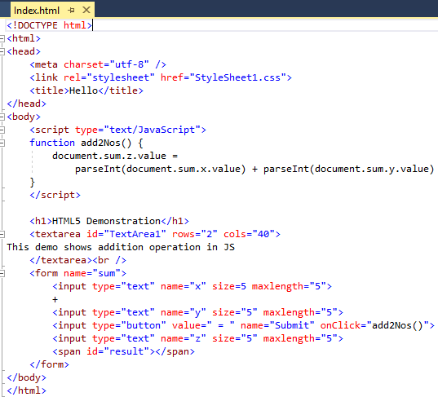
Adding JavaScript Code in HTML

Slide 18
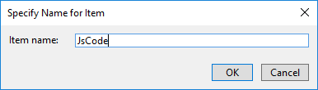
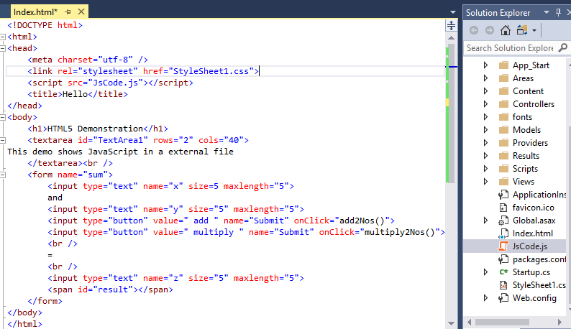
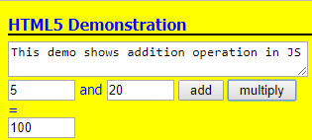
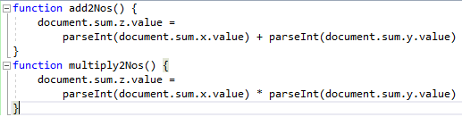
Adding a JavaScript File
Right Click Project → Add → JavaScript File
Name the file JsCode, and link it into Index.html page
View in Web Browser

Slide 19
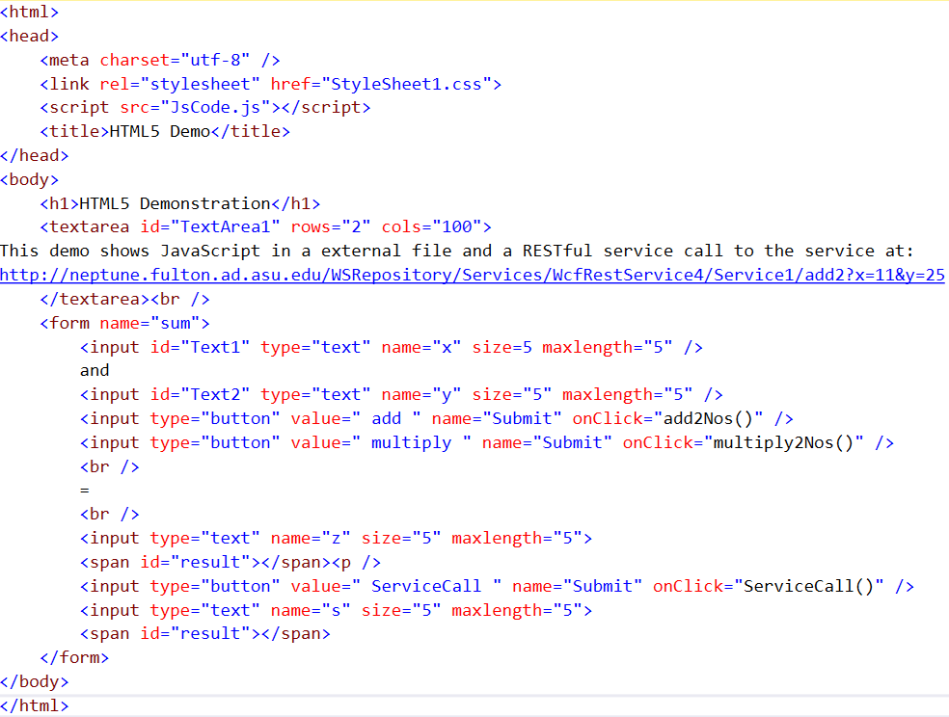
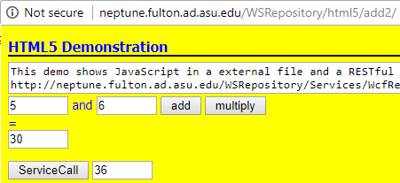
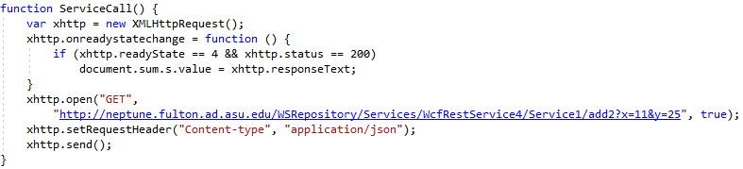
Calling A RESTful Service in JS
http://neptune.fulton.ad.asu.edu/WSRepository/html5/add2/
The ServiceCall is asynchronous:
The generated result will be sent to the html page;
Call the service and send the result to the response

Slide 20

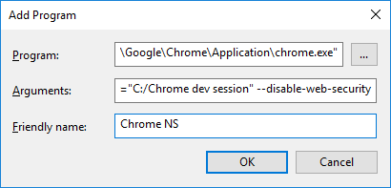
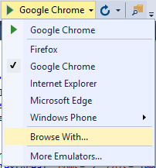
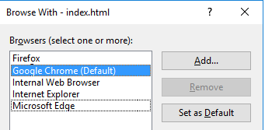
W3C: Cross-Origin Resource Sharing (CORS)
Testing: Disable Web browser security for testing XMLHttpRequest in Visual Studio
Click
1
2
3
2
--user-data-dir="C:/Chrome dev session" --disable-web-security
Browser security policy prevents a web page from making AJAX requests to another domain.
CORS is a W3C standard that allows a server to relax the same-origin policy (https://www.w3.org/TR/cors/).
Deployment, follow: https://docs.microsoft.com/en-us/aspnet/web-api/overview/security/enabling-cross-origin-requests-in-web-api
RESTful Service / Web API
CORS request
XMLHttpRequest
Web Client HTML

Slide 21
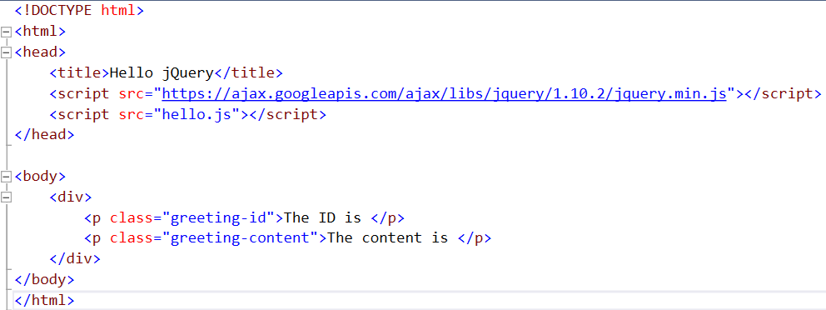
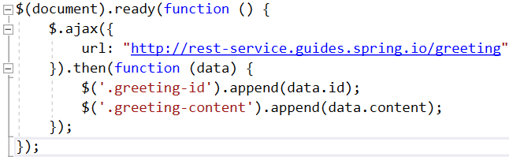
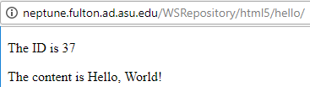
Calling A RESTful Service in jQuery
Source: https://spring.io/guides/gs/consuming-rest-jquery/
// hello.js
http://neptune.fulton.ad.asu.edu/WSRepository/html5/hello/

Slide 22
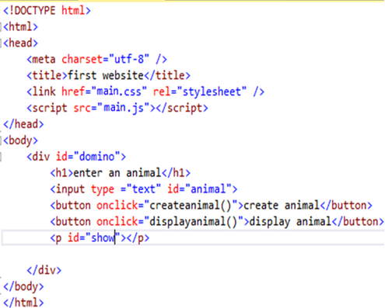
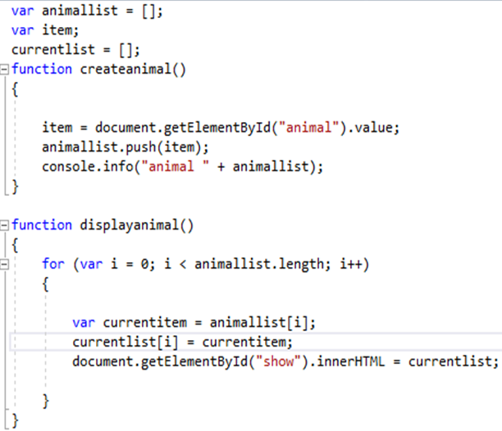
Example with Animation Definition
Where will the JS code be executed?
They will be executed in the browser.
They will be executed in the server.
They will be executed in the browser if they are embedded in the HTML file.
They will be executed in the server if they are embedded in the HTML file.

Slide 23
Creating HTML5 Applications
Using Visual Studio
NetBeans
was used for developing object-oriented software
was used for developing web services
can be used for developing HTML5 web applications

Slide 24
Preparation for NetBeans
Please check if the following recourses have been installed/included:
NetBeans IDE (pick either HTML5/JavaScript package or all package included) https://netbeans.org/downloads/index.html
Java Development Kit (JDK) version 7 or 8 (NetBeans 8.2 does not run JDK9!)
Chrome Browser
Add NetBeans Connector Extensions into Chrome Browser:
Go to the Chrome browser (https://chrome.google.com/webstore/detail/netbeansconnector/hafdlehgocfcodbgjnpecfajgkeejnaa?utm_source=chrome-ntp-icon) and click Add the NetBeans Connector page. Click Add when you are prompted to confirm that you want to add the extension

Slide 25

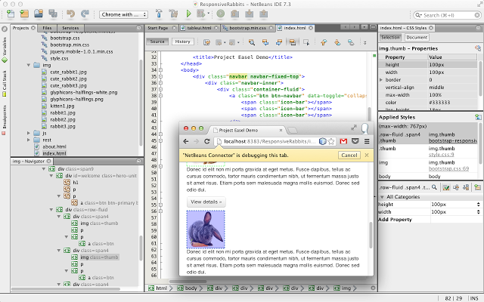
NetBeans Connector
https://chrome.google.com/webstore/detail/netbeansconnector/hafdlehgocfcodbgjnpecfajgkeejnaa?utm_source=chrome-ntp-icon

Slide 26
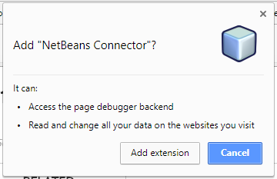
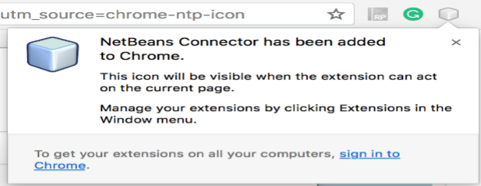
Add to Chrome

Slide 27
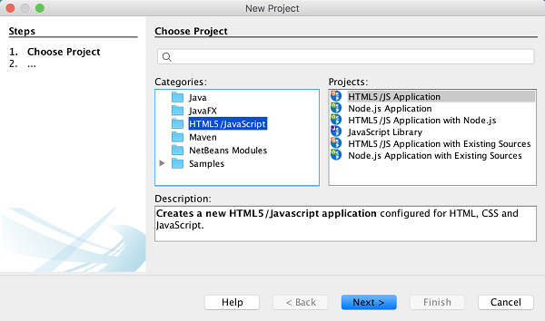
Now, Start NetBeans IDE

Slide 28
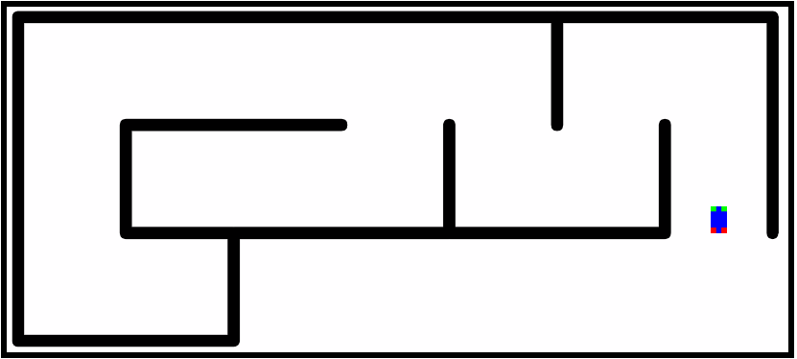
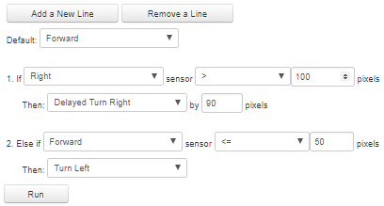
HTML5 Case Study: ASU IOT Maze Simulator
http://neptune.fulton.ad.asu.edu/VIPLE/Web2DSimulator/

Slide 29
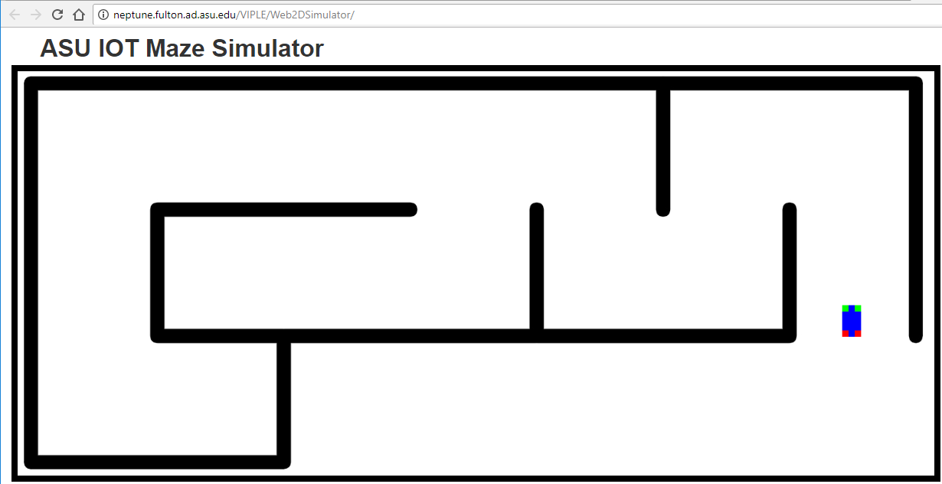
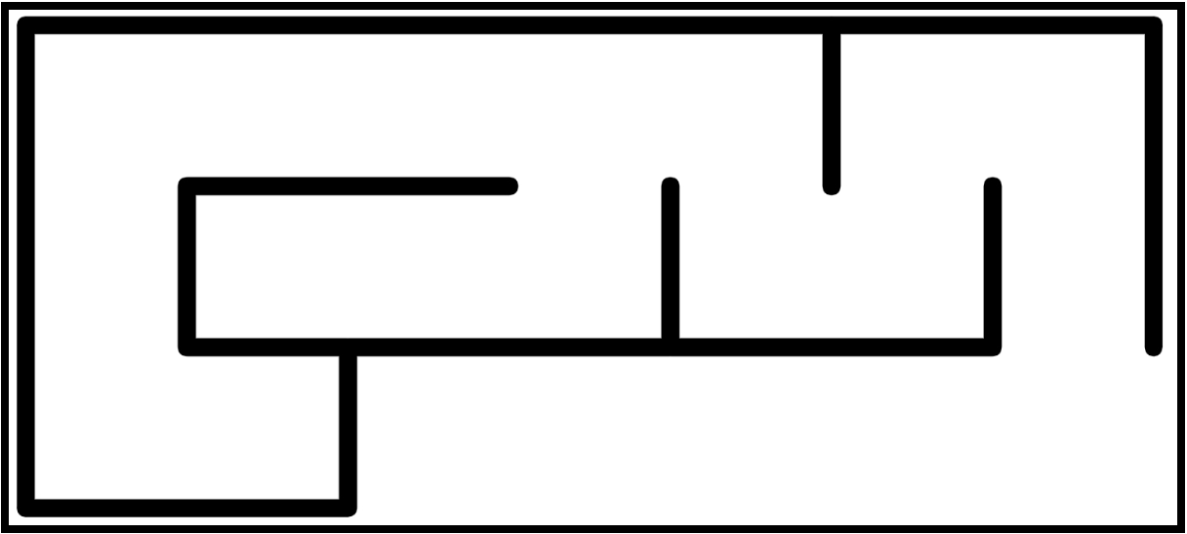
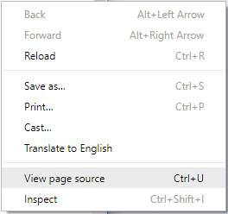
HTML5 Case Study: ASU IOT Maze Simulator
http://neptune.fulton.ad.asu.edu/VIPLE/Web2DSimulator/
Study the source code to learn Canvas-based animation
Right-click the page

Slide 30
HTML References from MSDN
Creating User Interface Elements with Canvas or SVG https://msdn.microsoft.com/en-us/library/gg589494(v=vs.85).aspx#creating_UI_elements_drawingUI
Introducing the HTML5 Canvas https://msdn.microsoft.com/en-us/magazine/hh708752.aspx

Slide 31
Why MVC Architecture
WCF RESTful Service
ASP .Net MVC 1 Application
Web API
RESTful Service
ASP .Net Core Web Application MVC 2
ASP .Net MVC 1 is a simple re-organization of ASP .Net Web Application.
ASP .Net Web Application
MVC 2 addresses all these issues
WCF SOAP Service
HTML5
Single Page Application with Client Side Computing
ASP .Net SOAP Service
HTML CSS
Java-Script &
JQuery
Canvas SVG WebGL
Desktop-based Forms Application
ASP .Net Web Application mixes two tiers together and add dependency.
ViewState is not well supported in server farms/cloud computing
HTML5 is mainly for one-page application.
Data are hard to transfer between pages.
Code viewable: Proprietary and security issues

Slide 32
MVC as an Architecture Pattern
Hardware Patterns
Software Patters
Patterns
Architecture Patterns (Client-server, tiered, MVC)
Computing Patterns (Computing paradigms)
Design Patterns (Creational, structural, behavioral, and currency patterns)
The MVC pattern was originally formulated in the late 1970s by Trygve Reenskaug at Xerox PARC, as part of the Smalltalk. [http://en.wikipedia.org/wiki/Model%E2%80%93view%E2%80%93controller].
In MVC, the system is divided into three groups of components:
Model: contains the components representing data and application logic for data processing;
View: Display the results from model;
Controller: It is between the Model and View. It takes input from the user, provides handlers of the inputs (simple processing), and let the model to process more complex functions.

Slide 33

J2EE’s MVC Architecture
Client Browser page
View:
What is sent to client browser
JSP Pages
Controller: Servlet
Java2EE Server
Model:
Enterprise Java Bean (EJB)
States and Data Sources
Enterprise Information System Database Server

Slide 34
Model, View, and Controller in ASP .Net
View: A directory contains the components that will generate the application's display (GUI) or the presentation layer of the application (output part).
Controller: A directory contains the components that handle user inputs, work with the model, and ultimately select a view to render the displays in GUI.
Model: A directory contains objects that that implement the part of the application logic related to the application's data domain. Often, model objects retrieve and store model state in a date sets, files, and database.

Slide 35
Automatically Generate Unit Test
http://msdn.microsoft.com/en-us/library/dd410597%28v=vs.100%29.aspx
In the project, right-click the Controllers folder, click Add, and then click Class.
In the Name text box, type MapsControllerTest.
Click Add.
namespace MvcBasicWalkthrough.Tests.Controllers {
[TestClass]
public class MapsControllerTest {
[TestMethod] public void ViewMaps() {
// Arrange
MapsController controller = new MapsController();
// Act
ViewResult result = controller.ViewMaps() as ViewResult;
// Assert
Assert.IsNotNull(result);
} } }

Slide 36
Benefits of MVC Architecture
The loosely coupled feature (compared with ASP .Net architecture) among the tiers in Views, Models, and Controllers:
Allow team members to develop different parts of the application with reduced interactions: GUI and code are separated;
The template can generate unit tests by automatically adding mock objects (simulated objects) that mimic the behavior of other objects in controlled ways in the application;
The restricted use of the view state, page postback, and related server controls, such as Gridview, allows the framework to render the XHTML page less dependent on the server features;
The MVC applications are more friendly with URI-based access used on RESTful services, the feed data formats, and cloud computing environment (CSE446).

Slide 37
The Evaluation Web Technologies
WCF RESTful Service
ASP .Net MVC 1 Application
Web API
RESTful Service
ASP .Net Core Web Application MVC 2
ASP .Net Web Application
WCF SOAP Service
HTML5
Single Page Application with Client Side Computing
ASP .Net SOAP Service
HTML CSS
Java-Script &
JQuery
Canvas SVG WebGL
Desktop-based Forms ApplicationHTML5
ASP .Net Framework
ASP .Net Core Framework
Other Frameworks
such as Netbeans

Slide 38
MVC 1 in ASP .Net: A Four Tier Architecture with loosely coupling among the tiers
View: The files that will generate the HTML files for client: the .aspx pages without .cs files
Controller: The aspx.cs files
Other controls and Computing Components and Services
Model: Objects that are process domain data for business logic
States and Data Sources

Slide 39
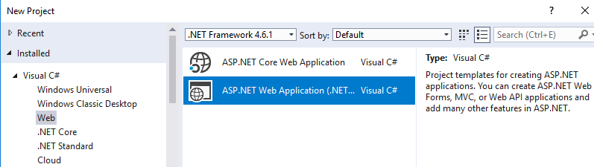
ASP .Net MVC Architecture (MVC 1)
Reading: Text Chapter 5, Section 5.7
ASP .Net offers MVC as an alternative project template;
It is available for Web Apps, Mobile Apps, and Cloud Apps, without using any View State!
Once selected the MVC template, the main components of the application will be organized in three directories: Models, Views, and Controllers.

Slide 40
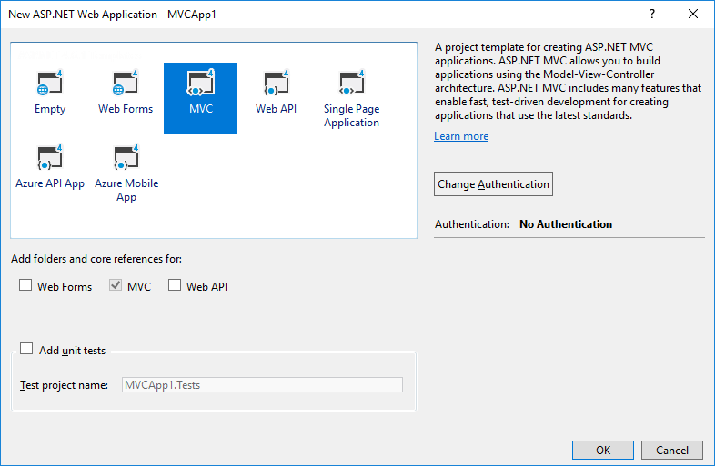
MVC can be applied for developing different apps

Slide 41
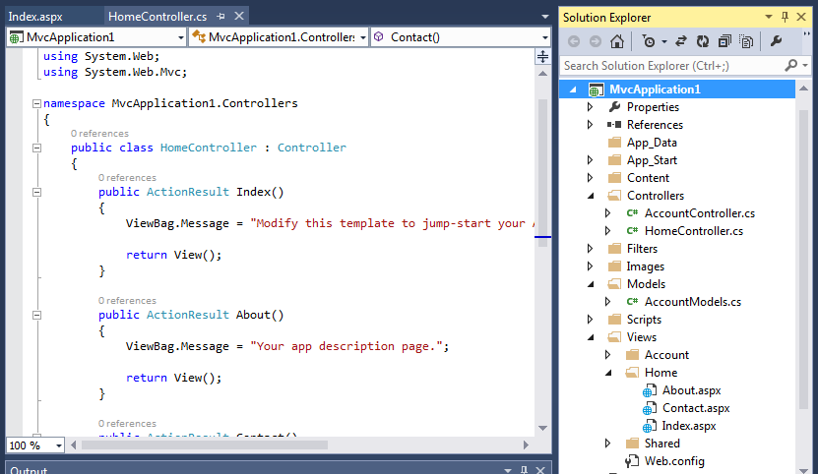
An MVC 1 Project: Organized Differently
.aspx.cs files, are moved to here
Put any business logic not related I/O are here
.aspx files, without .aspx.cs files

Slide 42
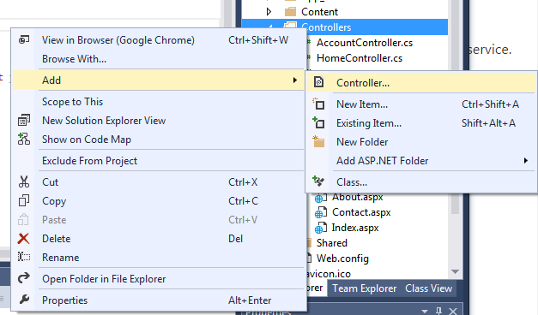
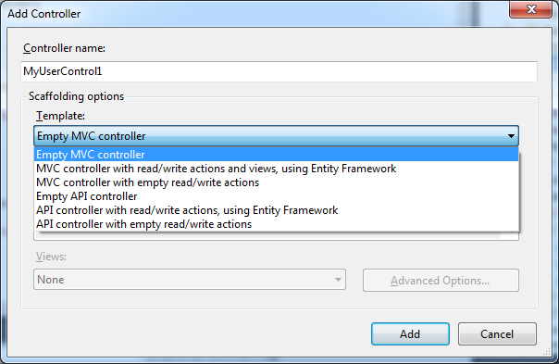
Add my Controller
Right click

Slide 43
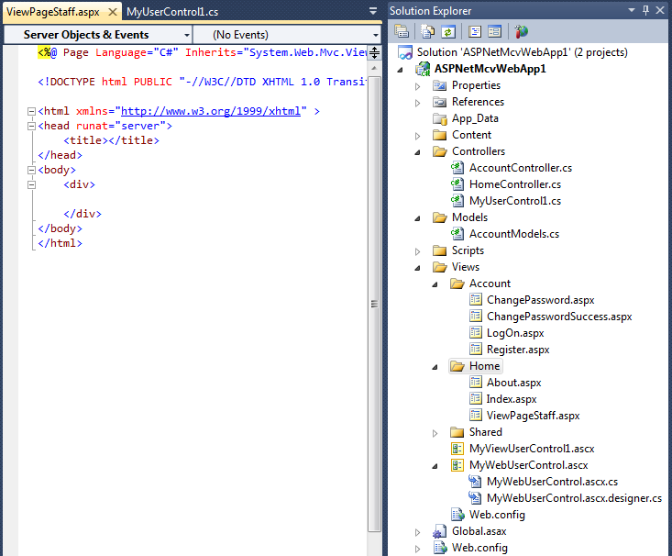
New Items are Added to the MVC 1 Project
MVC user control’s .cs file is added separately here.
A View Page is added here
A MVC user control. Only .ascx file is added
A traditional User control with both .ascx and .cs files

Slide 44
How are View and Controller Connected?
In ASP .Net, the .aspx files and .aspx.cs files are placed together in the same folder. The links are implicit. You must click the buttons to create the implicit links. It works because the two pages are tied together.
In MVC, the links are explicit.
Each View component (.aspx file) in browser contains a list of JavaScript calls.
The Controller of the component contains the methods to be called. View page and .cs page can be completely separated.

Slide 45
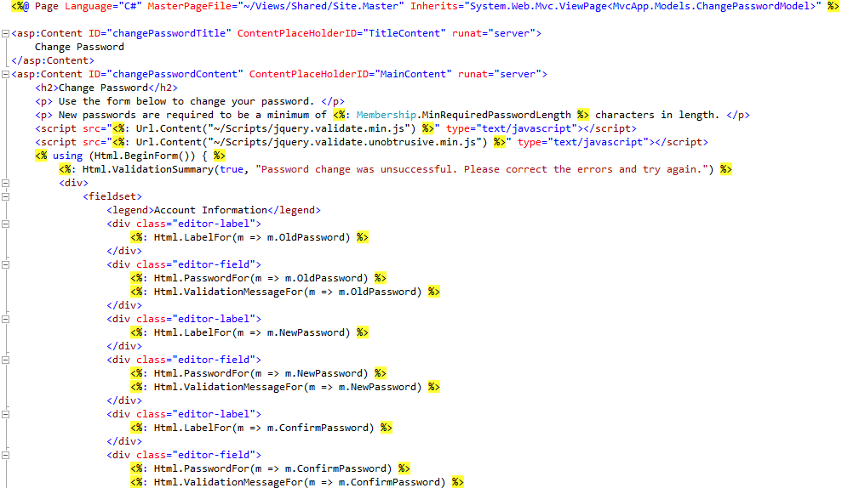
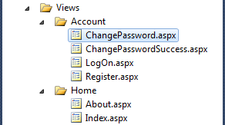
ChangePassword in ChangePassword.aspx, making JS calls

Slide 46

ChangePassword method in AccountController.cs
To be called from JavaScript
// POST: /Account/ChangePassword
[Authorize]
[HttpPost]
public ActionResult ChangePassword(ChangePasswordModel model) {
if (ModelState.IsValid) {
// ChangePassword will throw an exception rather than return false in certain failure scenarios.
bool changePasswordSucceeded;
try {
MembershipUser currentUser = Membership.GetUser(User.Identity.Name, true /* userIsOnline */);
changePasswordSucceeded = currentUser.ChangePassword(model.OldPassword, model.NewPassword);
}
catch (Exception){
changePasswordSucceeded = false;
}
if (changePasswordSucceeded) {
return RedirectToAction("ChangePasswordSuccess");
}
else {
ModelState.AddModelError("", "The current password is incorrect or the new password is invalid.");
}
}
// If we got this far, something failed, redisplay form
return View(model);
}

Slide 47

ChangePassword method in AccountModels.cs
public bool ChangePassword(string userName, string oldPassword, string newPassword) {
if (String.IsNullOrEmpty(userName)) throw new ArgumentException("Value cannot be null or empty.", "userName");
if (String.IsNullOrEmpty(oldPassword)) throw new ArgumentException("Value cannot be null or empty.", "oldPassword");
if (String.IsNullOrEmpty(newPassword)) throw new ArgumentException("Value cannot be null or empty.", "newPassword");
// The underlying ChangePassword() will throw an exception rather
// than return false in certain failure scenarios.
try {
MembershipUser currentUser = _provider.GetUser(userName, true /* userIsOnline */);
return currentUser.ChangePassword(oldPassword, newPassword);
}
catch (ArgumentException) {
return false;
}
catch (MembershipPasswordException) {
return false;
}
}
Access database

Slide 48
From MVC 1 to MVC 2
WCF RESTful Service
ASP .Net MVC 1 Application
Web API
RESTful Service
ASP .Net Core Web Application MVC 2
ASP .Net Web Application
WCF SOAP Service
HTML5
Single Page Application with Client Side Computing
ASP .Net SOAP Service
HTML CSS
Java-Script &
JQuery
Canvas SVG WebGL
Desktop-based Forms ApplicationHTML5
ASP .Net Framework
ASP .Net Core Framework
Other Frameworks
such as Netbeans

Slide 49
Case Study: Summer Camp Registration
Create the main page for information
Inviting for enrollment
Signup form
Store student list in a List structure
Showing Controllers → View
Showing Controllers → Model

Slide 50
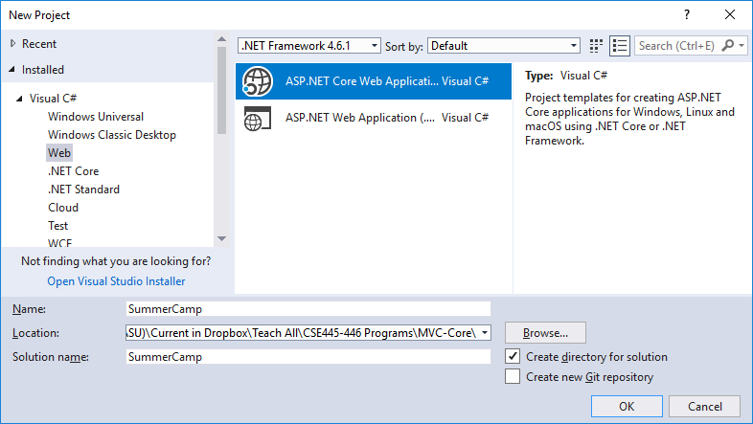
Getting Started with MVC 2 on ASP .Net Core

Slide 51

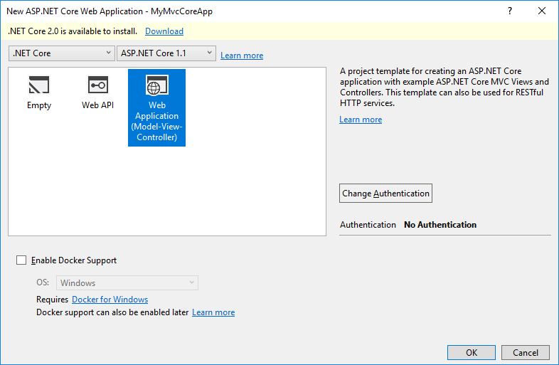
Updating to ASP .Net Core 2.0 from 1.1

Slide 52
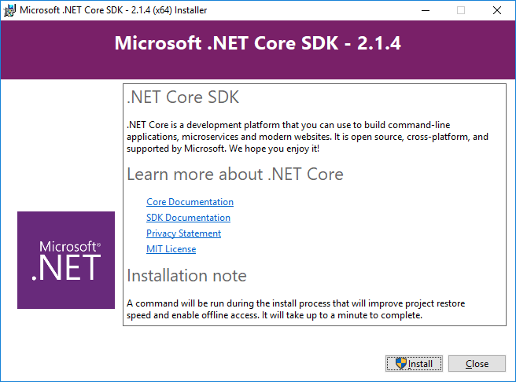
Updating to ASP .Net Core 2.0

Slide 53
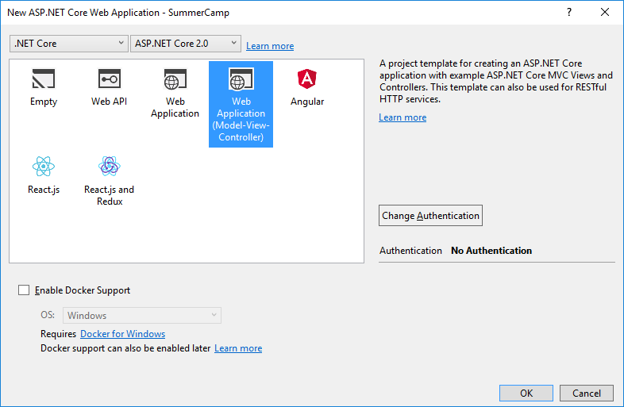
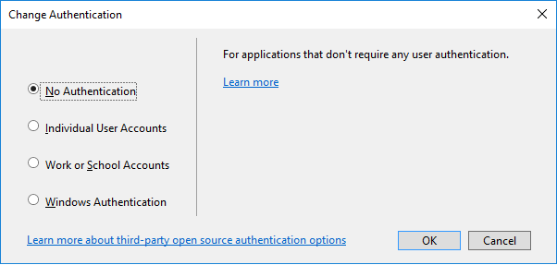
Updated to ASP .Net Core 2.0

Slide 54

MVC 2 Project in ASP .Net Core
MVC Controllers with .cs files
Models with .cs files
MVC Views with .cshtml files for html and binding with models:
@{ ViewData["Title"] = "Home Page"; }

Slide 55



Program Starting Point

Slide 56


HomeController: System Generated

Slide 57


Correlation Between Controller and View
Define “Title”

Slide 58


Modify the Index.cshtml Page
Write your code in Index page:
A page to be added

Slide 59



Modify HomeController.cs
Link the code to the SemesterView page

Slide 60

Add a New MVC View Page
Right Views-Home and Choose Add → New Item:

Slide 61


MVC View Page SignupForm Added

Slide 62

Add a Model to deal with Student Signup
Right-click Project → Add → Class

Slide 63



Define the Signup Information in Model Page
Start the Program and click Signup Now:
Take to the response form

Slide 64

Receive & Store Signed up Student Information
Add a Model for storing student list:

Slide 65

Use a List Type to Hold the Student List

Slide 66




Demo:

Slide 67
Chapter Summary
WCF RESTful Service
ASP .Net MVC 1 Application
Web API
RESTful Service
ASP .Net Core Web Application MVC 2
ASP .Net Web Application
Advanced WCF Services
HTML5
Single Page Application with Client Side Computing
ASP .Net SOAP Service
HTML CSS
Java-Script &
JQuery
Canvas SVG WebGL
Desktop-based Forms Application
ASP .Net Framework
ASP .Net Core Framework
Other Frameworks
such as Netbeans

